Slide 1
Basic Testing Concepts.
Mansoor Ahmed
18B-129-SE
Sec ”A”
HUMAN RESOURCE MANAGEMENT

Slide 2
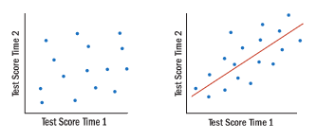
Reliability
Reliability is test’s first requirement and refers to its consistency.
A reliability test is one that yields consistent scores when a person takes two alternate forms of the test or when he or she takes the same test on two or more different occasions.
Can be figured out by comparing the results.

Slide 3

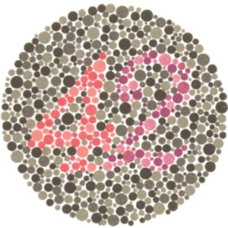
Rorschach Test
Night Blindness Test

Slide 4

Validity
Validity refers to how well a test measures what it was made to measure.
For a test to be reliable, it also needs to be valid.
For example, if your scale is off by 5 lbs., it reads your weight every day with an excess of 5lbs. The scale is reliable because it consistently reports the same weight every day, but it is not valid because it adds 5lbs to your true weight. It is not a valid measure of your weight.

Slide 5
Types of Validity
Test Validity
The accuracy with which a test, interview, and so on measures what it purports to measure or fulfills the function it was designed to fill.
Criterion Validity
A type of validity based on showing that scores on the test (predictors) are related to job performance (criterion).
Content Validity
A test that is content valid is one that contains a fair sample of the tasks and skills actually needed for the job in question.
Construct Validity
A test that is construct valid is one that demonstrates that a selection procedure measures a construct and that construct is important for successful job performance.
Face Validity
The stakeholders can easily assess face validity. Although this is not a very “scientific” type of validity, it may be an essential component in enlisting motivation of stakeholders.

Slide 6
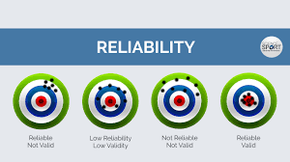
Graphical Representation of Reliability & Validity

Slide 7

Thank you!
جَزَاكَ ٱللَّٰهُ

